Slide 1

CS214 Object Oriented Programming

Slide 2
File Handling and Exception Handling

Slide 3
Contents to be covered in File Handling
Steams and Files
Stream classes & Stream Errors
File Pointers
File I/O with Member functions
Formatted I/O and I/O manipulators
Error handling during file operations
Overloading of extraction and insertion operators

Slide 4
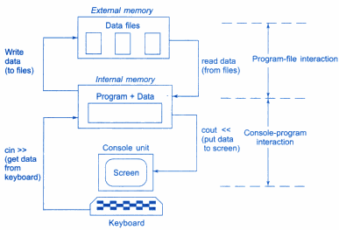
Console–program–file interaction

Slide 5
Streams
Stream is sequence of bytes
Name given to a flow of data
Represented by an object of a particular class
Used to represent different kinds of data flow
Interface between I/O and Program
Two streams
Input stream
Output stream
Input Stream
Extraction from Input Stream
Input Device
Program
Output Device
Insertion to output Stream
Output Stream
Input stream can come from keyboard or any other storage device.
Output stream can go to screen or any other storage device

Slide 6
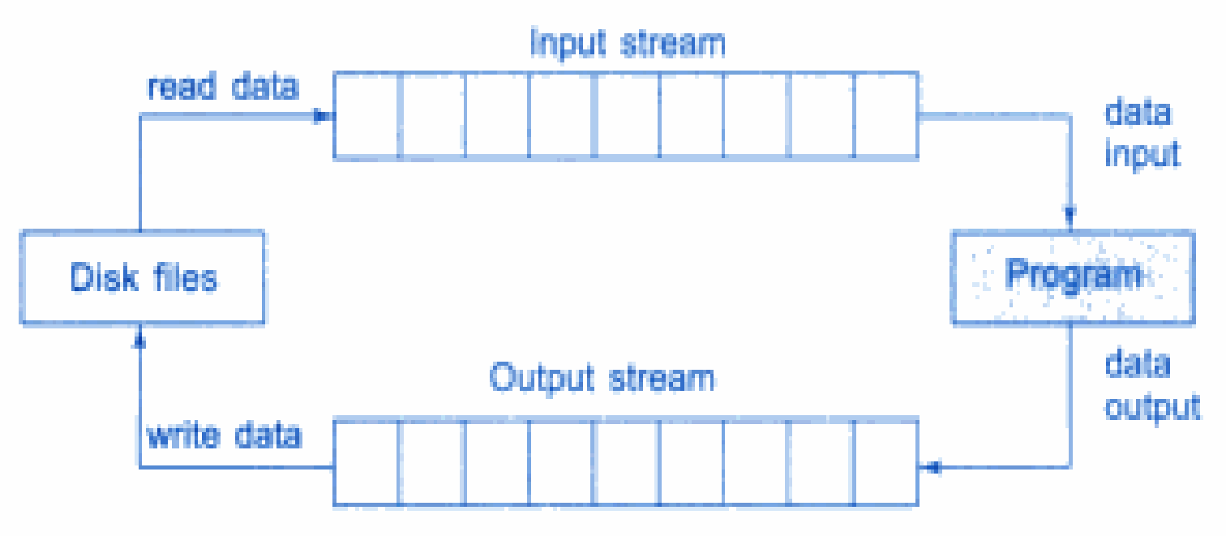
File input and output streams
Data is stored under a specific name on secondary storage devices using the concept of files
A file is a collection of related data stored in a particular area on the disk
Programs can be designed to perform the read and write operations on these files

Slide 7
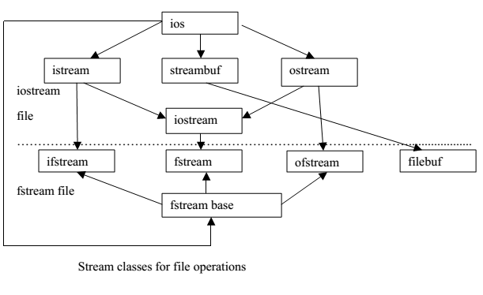
Stream Classes
Stream classes for file operations contained in fstream file

Slide 8
Stream Classes for I/O
Class name | Contents
ios (general input/output stream class) | Basic facilities that are used by all other input-output classes
istream (input stream) | Inherits properties of ios Has functions like get( ), getline( ), read( ) Contains operator >>
ostream (output stream) | Inherits properties of ios put( ), write( ) functions Contains operator <<
iostream (input/ output stream) | Inherits properties of istream and ostream through multiple inheritance and thus contains all input and output functions

Slide 9
File Handling
Types of File
1: ASCII Text File
Data Stored in ASCII character
Processed Sequentially in forward direction
EOF character is present at the end of file
2: Binary File
Data Stored in binary format
Processed randomly
Why to use File Handling
For permanent storage
The transfer of input - data or output - data from one computer to another can be easily done by using files

Slide 10
Stream Classes for Files
Class name | Contents
fstream (general file input/output stream class) | This is used to both read and write data from/to files Provides support for simultaneous input and output operations Contains open( ) with default input mode Inherits all the function from istream and ostream classes through iostream
ifstream (file input stream) | This is used to read data from files Provides input operations Contains open( ) with default input mode Inherits the functions get( ), getline( ), read(), seekg( ) and tellg( ) function from istream
ofstream (file output stream) | This is used to create a file and write data on files Provides output operations Contains open( ) with default output mode Inherits put( ), seekp( ), tellp( ) and write( ) function from ostream

Slide 11
Steps in File Handling
Following steps are followed in File I/O Process:
Include the header file fstream in the program i.e. #include<fstream.h>
Declare file stream object i.e. ofstream fout;
ifstream fin;
3. Open the file with the file stream object i.e. fout.open(“country.txt”);
fin.open(“capital.txt”);
4. Use the file stream object with >>, <<, or other input/output functions
i.e. fout<<“India “;
fout<<“United states of America”;
fin>>name;
5. Close the files i.e. fout.close();
fin.close();

Slide 12
Functions used in File Handling
Function | Operation
open( ) | To open/create a file
close( ) | To close an existing file
get( ) | Read a single character from a file
put( ) | write a single character in file
read( ) | Read data from file
write( ) | Write data into file

Slide 13
File open()
Two ways to open file
By Using Constructor
By Using open() function
By using Constructor:
The file is opened while creating object of stream classes
Syntax:
file_stream_class stream_object(“filename”);
#include<fstream>
using namespace std;
int main()
{
ifstream fin("abc.txt");
ofstream fout("xyz.txt");
}
abc.txt open in input mode
abc.txt
Hi,
Welcome to MITWPU
xyz.txt open in output mode
xyz.txt
Hello
Welcome to CSE dept

Slide 14
Working with Single File
//Creating files with Constructor function
#include <iostream>
#include<fstream.h>
using namespace std;
int main()
{
char name[30];
float cost;
ofstream outf(“PRODUCT.TXT”);
cout <<”Enter Product Name: “;
cin >>name;
outf <<name <<”\n”;
cout <<”Enter Product Cost :”;
cin >>cost;
outf <<cost <<“\n”;
outf.close();
ifstream inf(“PRODUCT.TXT”);
inf >>name;
inf >>cost;
cout <<”\n”;
cout <<”Product Name : “ << name <<”\n”;
cout <<”Product Cost: “ << cost <<”\n”;
inf.close();
return 0;
}
Output:
Enter Product Name: Pen-Drive
Enter Product Cost : 750.50
Product Name : Pen-Drive
Product Cost: 750.50

Slide 15
File open()
Two ways to open file
By Using Constructor
By Using open() function
2) By using open() function:
The function open() can be used to open multiple files that use the same stream object
Syntax:
file-stream-class stream-object;
stream-object . open (“filename”, mode);
#include<fstream>
int main()
{
ifstream fin;
fin.open("abc.txt");
ofstream fout;
fout.open("xyz.txt");
fstream file;
file.open("pqr.txt");
}
abc.txt open in input mode
abc.txt
Hi,
Welcome to MITWPU
xyz.txt open in output mode
xyz.txt
Hello
Welcome to CSE dept
pqr.txt open in input & output mode
pqr.txt
Object Oriented Programming

Slide 16
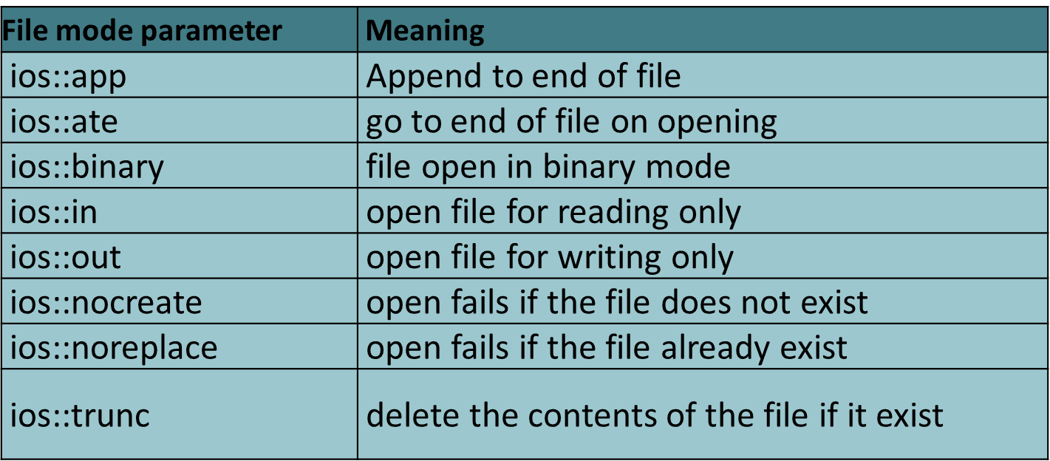
File Opening Modes
#include<fstream>
int main()
{
ifstream fin;
fin.open("abc.txt",ios::in);
ofstream fout;
fout.open("xyz.txt",ios::out);
fstream file;
file.open("pqr.txt",ios::out|ios::app);
}
abc.txt open in input mode
abc.txt
Hi,
Welcome to MITWPU
xyz.txt open in output mode
xyz.txt
pqr.txt open in output & append mode
Hello
Welcome to CSE dept
pqr.txt
Object Oriented Programming

Slide 17
File close()
The function close() is used to close file. File must be closed after completing all operations on it
Syntax: stream_object.close();
#include<fstream>
int main()
{
ifstream fin;
fin.open("abc.txt",ios::in);
ofstream fout;
fout.open("xyz.txt",ios::out);
fstream file;
file.open("pqr.txt",ios::out|ios::app);
fin.close();
fout.close();
file.close();
}
abc.txt open in input mode
abc.txt
Hi,
Welcome to MITWPU
xyz.txt open in output mode
xyz.txt
Hello
Welcome to CSE dept
test .txt open in output & append mode
test.txt
Object Oriented Programming

Slide 18
Working with Multiple Files
//Creating files with open( ) function
#include <iostream>
#include<fstream.h>
using namespace std;
int main()
{
ofstream fout;
fout.open(“country.txt”);
fout<<“India \n”;
fout<<“United states of America \n”;
fout<<“United Kingdom \n”;
fout.close();
fout.open(“capital.txt”);
fout<<”New Delhi \n”;
fout<<”Washington\n”;
fout<<”London\n”;
fout.close();
const int N =80; //size of line
char line[N];
ifstream fin;
fin.open(“country.txt”);
cout<<“contents of country file \n”;
while (fin)
{
fin.getline(line,N);
cout<<line;
}
fin.close();
fin.open(“capital.txt”);
cout<<“contents of capital file”;
while(fin)
{
fin.getline(line, N);
cout<<line;
}
fin.close();
return 0;
}
Output:
contents of country file
India
United states of America
United Kingdom
contents of capital file
New Delhi
Washington
London

Slide 19
bool is_open( )
This function returns true if the file is opened and associated with this stream. Otherwise, it returns false:
Syntax: fin.is_open();
#include<fstream>
using namespace std;
int main()
{
ifstream fin;
fin.open("abc.txt");
if (!fin.is_open())
cout<<"Cannot open file!"<<endl;
fin.close();
}
return 1 if file is open else return 0
abc.txt
Hi, Welcome

Slide 20
Functions used in Input/output Operations
Function | Operation | Parameter
get( ) | Read a single character from a file | ch=cin.get(); OR cin.get(ch); ch=fin.get(); OR fin.get(ch)
getline() | Read a line or text that ends with a newline character from a file | getline(cin, line) getline(cin, line,delimchar) OR getline(fin, line) getline(fin, line, delimchar)
put( ) | write a single character in file. | cout.put(ch) OR fout.put(ch)
read( ) | Read data from file | file . read ((char *)&V , sizeof (V));
write( ) | Write data into file | file . write ((char *)&V , sizeof (V));
>> operator (Extraction) | Read data from file | cin>>ch OR fin>>ch
<< operator(Insertion) | Write data into file | cout<<ch OR fout<<ch

Slide 21
Reading and Writing into file using get() and put()
get() function reads single character from file and put() function writes single character to file
Syntax: ch=fin.get(); OR fin.get(ch)
fout.put(ch)
#include<fstream>
using namespace std;
int main( ) {
ifstream fin;
fin.open("abc.txt");
ofstream fout;
fout.open("xyz.txt");
char ch=‘H’;
fin.get(ch);
fout .put(ch);
fin.close( );
fout.close( );
return 0;
}
abc.txt open in input mode
abc.txt
H
xyz.txt open in output mode
xyz.txt
H

Slide 22
I / O Operations on characters
// Character I/O with get() and put()
#include <iostream>
using namespace std;
int main()
{
int count=0;
char c;
cout<<“INPUT TEXT :\n”;
cin.get( c );
while ( c !=‘\n’)
{
cout.put(c);
count++;
cin.get( c );
}
cout<< “\n Number of characters =” <<count <<”\n”;
return 0;
}
Input:
INPUT TEXT :
Object oriented programming
Output:
Object oriented programming
Number of characters=27

Slide 23
I / O Operations on characters
#include <iostream>
#include<fstream.h>
#include<string.h>
using namespace std;
int main()
{
char str[80];
cout<<”Enter a string: \n”;
cin>>str;
int len =strlen(str);
fstream file;
cout<<“\n Opening the ‘Demo.txt’ file and storing the string in it. \n\n”);
file.open(“Demo.txt”, ios::in |ios::out);
for (int i=0;i<len;i++)
file.put(str[i]);
file.seekg(0); //go to the start
char ch;
cout<<“Reading the file contents:” ;
while(file)
{
file.get(ch);
cout<<ch;
}
return 0;
}
Output:
Enter a string: C++_Programming
Opening the ‘Demo.txt’ file and storing the string in it.
Reading the file contents: C++_Programming

Slide 24
getline()
getline() function reads a line or text that ends with a newline character from a file
Syntax: getline (object, char* str, char delim = ‘\n’);
getline(fin, line)
getline(fin, line, delimchar)
#include<fstream>
using namespace std;
int main() {
string str;
ifstream fin;
fin.open("test.txt");
getline(fin,str);
cout<<"Data of File is"<<endl;
cout<<str;
fin.close();
return 0;
}
test.txt
Hi, Welcome to MITWPU
Reads a line from file
Output Screen
Data of file is
Hi, Welcome to MITWPU

Slide 25
Reading and Writing into file using >> & << operator
Extraction >> operator reads data from file and Insertion << operator writes data to file
Syntax: fin>>ch
fout<<ch
#include<fstream>
using namespace std;
int main() {
ifstream fin;
fin.open("abc.txt");
ofstream fout;
fout.open("xyz.txt");
char ch[30];
fin>>ch;
fout << ch;
fin.close( );
fout.close( );
return 0;
}
abc.txt
Hi, Welcome
Reads a data from file abc.txt
xyz.txt
Writes a data to file xyz.txt
Hi, Welcome

Slide 26
read() & write() Functions
read( ) function reads a data from file and write( ) function writes a data to file
Syntax: file . read ((char *)&V , sizeof (V));
file . write ((char *)&V , sizeof (V));

Slide 27
I / O Operations on Binary Files
#include <iostream>
#include<fstream.h>
#include<iomanip.h>
using namespace std;
int main()
{
float data[4]={175.8,157.0,180.25,151.457}
ofstream outfile;
outfile.open(“Demo.txt”);
outfile.write((char *)& data, sizeof(data));
outfile.close();
for(int i=0;i<4;i++)
data[i]=0;
ifstream infile;
infile.open(“Demo.txt”);
infile.read((char *)& data, sizeof(data));
for(int i=0;i<4;i++)
{
cout.setf(ios::showpoint);
cout<<setw(10);
cout<<setprecision(2)<<data[i];
}
infile.close();
return 0;
}
Output:
175.80 157.00 180.25 151.45

Slide 28
Reading and Writing a Class Object
#include <iostream>
#include<fstream.h>
#include<iomanip.h>
class store
{
char name [10];
int code;
float cost;
public:
void readdata();
void displaydata();
};
void store :: readdata()
{
cout<< "Enter Book name:” ;
cin>>name;
cout<< "Enter Book code: ”;
cin>> code;
cout <<"Enter cost : ;
cin>>cost;
}
void store :: displaydata ()
{
cout<< setiosflags(ios: : left)
<<setw(10) <<name
<< setiosflags(ios: :right)
<<setw(10) <<code
<<setprecision(2)<<setw(10)
<<cost<<endl;
}
int main()
{
store product[3];
fstream file;
file.open(“book.txt”, ios::in |
ios::out);
cout<<“Enter Details of 3 books”;
for(int i=0; i<3; i++)
{
product[i].readdata();
file.write((char *) &product[i], sizeof(product[i]));
}
file.seekg(0);
cout<<“\BOOK DETAILS :\n\n”;
for(int i=0; i<3; i++)
{
file.read((char *) &product[i], sizeof(product[i]));
product[i].displaydata();
}
file.close();
return 0;
}
Output:

Slide 29
read() & write() Functions
class Student
{
int rollno;
string name;
public:
void getdata()
{
cout<<"enter roll no & name of student";
cin>>rollno>>name;
}
void putdata()
{
cout<<"Roll"<<rollno;
cout<<"Name";
cout<<name;
}
};
int main()
{
Student S1,S2;
S1.getdata();
fstream file;
file.open(“test.dat",ios::binary);
file.write((char *)&S1,sizeof(S1));
file.read((char *)&S2,sizeof(S2));
S2.putdata() ;
file.close();
return 0;
}
test.txt
11
Abc
Output Screen
Roll 11
Name Abc

Slide 30
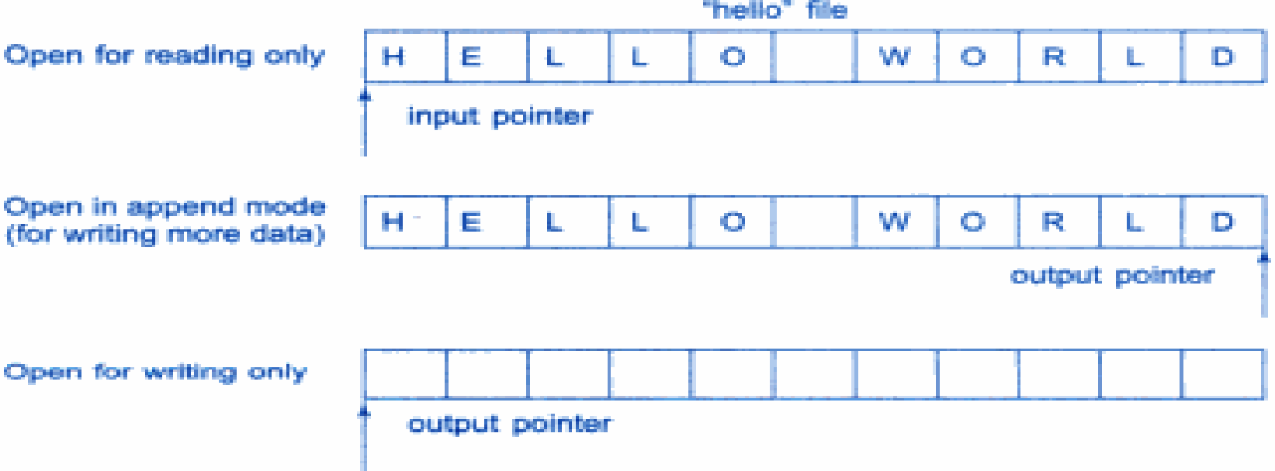
File Pointers
Each file have two associated pointers known as the file pointers
One of them is called the Input Pointer (or get pointer)
The other is called the Output Pointer (or put pointer)
The input pointer is used for reading the contents of a given file location and the output pointer is used for writing to a given file location
Action on file pointers while opening a file

Slide 31
Functions for Manipulation of File Pointers
To move file pointer to desired position use these function to manage the file pointers
seekg( ) : moves get pointer (input) to a specified location
seekp( ) : moves put pointer (output) to a specified location
tellg( ) : gives the current position of the get pointer
tellp( ) : gives the current position of the put pointer
For example
infile.seekg(10);
moves the file pointer to the byte number 10
ofstream fileout;
fileout.open(“welcome.txt”,ios::app);
int p=fileout.tellp( );

Slide 32
File Manipulation functions
Function | Operation
seekg(0, ios :: beg) | go to start
seekg(0, ios :: cur) | stay at current position
seekg(0, ios :: end) | go to the end of file
seekg(m, ios :: beg) | move to m+1 byte in the file
seekg(m, ios :: cur) | go forward by m bytes from the current position
seekg(-m, ios :: cur) | go backward by m bytes from the current position
seekg(-m, ios :: end) | go backward by m bytes from the end

Slide 33
Program to set file pointer
fstream file;
file.open("test.txt");
if(!file.is_open())
{cout << " Cannot open file!"; }
file << "This is the first line “<<endl;
file << "This is the second line" <<endl;
file.seekg(ios::beg);
for (int i = 0; i != 5; ++i) {
cout << (char)file.get() << endl;
}
char next = file.get();
cout << "The next character is " << (char)next ;
cout<<endl;
file.seekg(ios::beg);
char* str = new char[50];
file.getline(str, 50);
cout << str << endl;
file.ignore();
cout << "Peek " << (char) file.peek() << endl;
cout << "Current position is " << file.tellg() << endl;
file.close( ); }
open file test.txt for input and output
test.txt
This is the first line
This is the second line
reset position of the input
Output Screen
T
h
i
s
The next character is=i
This is the first line
Peek= h
Current position is= 24
reset position again
show the next character without
extracting it from file
get current position

Slide 34
Error Handling functions
Streams have error state, Flags are set if error occurs
FUNCTION | RETURN VALUE AND MEANING
eof() | returns true (non zero) if end of file is encountered while reading; otherwise return false(zero)
fail() | return true when an input or output operation has failed
bad() | returns true if an invalid operation is attempted or any unrecoverable error has occurred.
good() | returns true if no error has occurred.

Slide 35
Program to check stream errors
using std::ios;
using std::cout;
using std::endl;
using std::cin;
int main() {
int integerValue;
cout<<"Before a Bad input operation: "
<<"\ncin.rdstate(): “<<cin.rdstate()
<<"\n cin.eof():"<<cin.eof();
cout<<"\ncin.fail(): “<<cin.fail() <<"\ncin.bad(): “<<cin.bad()
<<"\ncin.good(): "<<cin.good()
<<"\n\nExpects an integer, but enter a character: ";
cin>>integerValue;
cout<<endl;
cout<<"After a bad input operation: "
<<"\n cin.rdstate(): "<<cin.rdstate() <<"\n cin.eof(): "<<cin.eof() <<"\n cin.fail(): "<<cin.fail()
<<"\n cin.bad(): "<<cin.bad()
<<"\n cin.good(): "<<cin.good() <<endl<<endl;
cin.clear(ios::goodbit);
cout<<"After cin.clear()" <<"\ncin.fail(): "<<cin.fail()
<<"\ncin.good(): "<<cin.good()<<endl<<endl;
return 0; }
Output Screen
Before a Bad input operation:
cin.rdstate(): 0
cin.eof():0
cin.fail():0
cin.bad(): 0
cin.good(): 1
Expects an integer, but enter a character: a
After a bad input operation:
cin.rdstate(): 4
cin.eof(): 0
cin.fail(): 1
cin.bad(): 0
cin.good(): 0
After cin.clear()
cin.fail(): 0
cin.good(): 1

Slide 36
Overloading stream insertion (<<) and extraction (>>) operators
In C++, stream insertion operator “<<” is used for output and extraction operator “>>” is used for input.
We must know following things before we start overloading these operators.
1) cout is an object of ostream class and cin is an object istream class
2) These operators must be overloaded as a global function.
And if we want to allow them to access private data members of class, we must make them friend.

Slide 37
Program for operator overloading
#include <iostream>
using namespace std;
class Complex{
private:
int real, imag;
public:
Complex(int r = 0, int i =0) {
real = r; imag = i;
}
friend ostream & operator << (ostream &out, const Complex &c);
friend istream & operator >> (istream &in, Complex &c);
};
ostream & operator << (ostream &out, const Complex &c) {
out << c.real;
out << "+i" << c.imag << endl;
return out;
}
istream & operator >> (istream &in, Complex &c) {
cout << "Enter Real Part ";
in >> c.real;
cout << "Enter Imagenory Part ";
in >> c.imag;
return in;
}
Overloading function for insertion
Overloading function for Extraction

Slide 38
Exception Handling Topics
Exception Handling
Exception Handling Mechanism
Multiple Exceptions, re-throwing an exception
Exception and Inheritance.

Slide 39
Exception
An exception is a unusual, often unpredictable event, detectable by software or hardware, that requires special processing occurring at runtime
In C++, a variable or class object that represents an exceptional event.

Slide 40
Exception Handling
Exceptions
Indicate problems that occur during a program’s execution
Occur infrequently
If without handling,
Program crashes
Falls into unknown state
An exception handler is a section of program code that is designed to execute when a particular exception occurs
Exception handling
Can resolve exceptions
Allow a program to continue executing or
Notify the user of the problem and
Terminate the program in a controlled manner
Makes clear, robust, fault-tolerant programs
C++ removes error handling code from "main line" of program

Slide 41
Standard Exceptions
Exceptions thrown by the Language
Exceptions thrown by Standard Library Routines
Exceptions thrown by user code, using throw statement

Slide 42
Importance of Exception Handling
Programmers can handle any exceptions they choose
All exceptions
All exceptions of a certain type
All exceptions of a group of related types
A standard mechanism for processing errors
Especially important when working on a project with a large team of programmers
With exception handling, a program can continue executing (rather than terminating) after dealing with a problem.
When no exceptions occur, there is no performance penalty

Slide 43
The try-catch Statement
How one part of the program catches and processes the exception that another part of the program throws.
Try-Catch Statement
try
Block
catch (Formal Parameter)
Block
catch (Formal Parameter)
Formal Parameter
DataType VariableName
…

Slide 44
Example: Exception Handling
#include <iostream>
using namespace std;
int main()
{
int a=10,
int b=0,
int c;
c=a/b;
cout<<c;
return 0;
}
#include <iostream>
using namespace std;
int main()
{
int a=10,b=0,c;
try //try block activates exception handling
{
if (b!=0)
{
c=a/b;
cout<<c;
}
else
{
throw(b); //throws exception
}
}
catch(int i) //catches exception
{
cout<< “Division by zero not possible”
}
cout<<“ End of Program”;
return 0;
}
Output:
Division by zero not possible
End of Program
Above program compiles successful but the program fails during run time
Output: Floating point exception (core dumped)

Slide 45
The throw Statement
Throw:
to signal the fact that an exception has occurred; also called raise
Throw Statement
throw Expression

Slide 46
Execution of try-catch
A
statement throws
an exception
No
statements throw
an exception
Exception
Handler
Control moves directly to exception handler
Statements to deal with exception are executed
Statement
following entire try-catch
statement

Slide 47
Throwing an Exception to be Caught by the Calling Code
void Func3()
{
try
{
Func4();
}
catch ( ErrType )
{
}
}
Function
call
void Func4()
{
if ( error )
throw ErrType();
}
Normal
return
Return from
thrown exception

Slide 48
Practice: Dividing by ZERO
Apply what you know:
int Quotient(int numer, // The numerator
int denom ) // The denominator
{
if (denom != 0)
return numer / denom;
else
//What to do?? do sth. to avoid program crash
}

Slide 49
A Solution
int Quotient(int numer, // The numerator
int denom ) // The denominator
{
if (denom == 0)
throw DivByZero();
//throw exception of class DivByZero
return numer / denom;
}

Slide 50
A Solution
// quotient.cpp -- Quotient program
#include<iostream> #include <string.h>
using namespace std;
int Quotient( int, int );
class DivByZero
{
}; // Exception class
int main( )
{
int numer; // Numerator
int denom; // Denominator
//read in numerator and denominator
while(cin)
{
try
{
cout << "Their quotient: "
<< Quotient(numer, denom) <<endl;
}
catch ( DivByZero ) //exception handler
{
cout<<“Denominator can't be 0"<< endl;
}
// read in numerator and denominator }
return 0;
}

Slide 51
Basics of C++ Exception Handling: try, throw, catch
A function can throw an exception object if it detects an error
Object typically a character string (error message) or class object
If exception handler exists, exception caught and handled
Otherwise, program terminates
type function (arg list) //Function with exception
{
……
……
throw(object); // Throws exception
}
…….
…….
try
{
……// Invoke function here
……
}
catch(type arg) //Catches exception
……
……
……// Handles exception here
}
……..

Slide 52
INVOKINGS FUNCTION THAT GENERATES EXCEPTION
//INVOKINGS FUNCTION THAT GENERATES EXCEPTION
# include <iostream>
using namespace std;
void divide (int x, int y, int z)
{
cout<<”we are inside the function”;
if ( ( x-y) != 0)
{
int r=z/(x-y);
cout<<”Result = “<<r;
}
else
{
throw(x-y);
}
}
int main()
{
try
{
cout<<”we are inside the try block”;
divide(10,20,30);
divide(10,10,20);
}
catch (int i)
{
cout<<”caught the exception”;
}
return 0;
}
Output:
We are outside the try block
We are inside the function
Result = -3
We are inside the function
Caught the exception

Slide 53
Basics of C++ Exception Handling: try, throw, catch
Format
Enclose code that may have an error in try block
Follow with one or more catch blocks
Each catch block has an exception handler
If exception occurs and matches parameter in catch block, code in catch block executed
If no exception thrown, exception handlers skipped and control resumes after catch blocks
throw point - place where exception occurred
Control cannot return to throw point

Slide 54
try Block
Keyword try followed by braces ({})
Should enclose
Statements that might cause exceptions
Statements that should be skipped in case of an exception

Slide 55
Throwing an Exception
throw - indicates an exception has occurred
Forms of throw statement
throw(exception);
throw exception;
throw; //used for rethrowing an exception
Usually has one operand (sometimes zero) of any type
If operand an object, called an exception object
Conditional expression can be thrown
Code referenced in a try block can throw an exception
Exception caught by closest exception handler
Control exits current try block and goes to catch handler (if it exists)
Example (inside function definition)
if ( denominator == 0 )
throw DivideByZeroException();
Throws a dividebyzeroexception object

Slide 56
Catching an Exception
Exception handlers are in catch blocks
Format: catch( exceptionType parameterName){
exception handling code
}
Caught if argument type matches throw type
If not caught then terminate called which (by default) calls abort
Example:
catch ( DivideByZeroException ex) {
cout << "Exception occurred: " << ex.what() <<“\n”
}
Catches exceptions of type DivideByZeroException

Slide 57
Catch Handlers
Immediately follow a try block
One or more catch handlers for each try block
Keyword catch
Exception parameter enclosed in parentheses
Represents the type of exception to process
Can provide an optional parameter name to interact with the caught exception object
Executes if exception parameter type matches the exception thrown in the try block
Could be a base class of the thrown exception’s class

Slide 58
Multiple Catch Handlers
If a program segment has more than one condition to throw an exception then
Associate More than one catch statement with a try
try { // code to try
}
catch (type1 arg)
{ // handle exceptions of type1
}
catch (type2 arg)
{ // handle exceptions of type2
}
. . . . .
. . . . .
catch (typeN arg)
{ // handle exceptions of typeN
}
...
/* code to execute if no exception or catch handler handled exception*/

Slide 59
Example of a try-catch Statement
try
{
// Statements that process personnel data and may throw
// exceptions of type int, string, and SalaryError
}
catch ( int )
{
// Statements to handle an int exception
}
catch ( string s )
{
cout << s << endl; // Prints "Invalid customer age"
// More statements to handle an age error
}
catch ( SalaryError )
{
// Statements to handle a salary error
}

Slide 60
MULTIPLE CATCH STATEMENTS
# include <iostream>
using namespace std;
void test (int x)
{
try
{
if (x= =1) throw x; //int
else
if(x= =0) throw ‘x’; //char
else
if (x= = -1 ) throw 1.0; //double
cout<<”End of try- block \n”;
}
catch(char c) //Catch 1
{
cout<<”Caught a character \n”;
}
catch (int m) //Catch 2
{ cout <<”caught an integer\n”;
}
catch (double d) //catch 3
{
cout<<”caught a double \n”;
}
cout<<”End of try –catch system \n\n”;
}
int main()
{
cout<<”Testing multiple catches \n”;
cout<<”x== 1 \n”;
test(1);
cout<<”x== 0 \n”;
test(0);
cout<<”x == -1 \n”;
test (-1);
cout <<”x== 2 \n”;
test (2);
return 0;
}
Output:
Testing Multiple Catches
X== 1
Caught an Integer
End of try-catch System
X==0
Caught a character
End of try-catch System
X== -1
Caught a double
End of try-catch System
X== 2
End of try-block
End of try-catch System

Slide 61
Catching All Exceptions
Catch all exceptions
You do not know what type of exception occurred
There is no parameter name - cannot reference the object
To catch all exceptions instead of a certain type alone
catch(...)
{
// Statements for processing all exceptions
}
If no handler matches thrown object
Searches next enclosing try block
If none found, terminate called
If found, control resumes after last catch block
If several handlers match thrown object, first one found is executed

Slide 62
Catching All Exceptions
# include <iostream>
using namespace std;
void test(int x)
{
try
{
if (x= = 0) throw x; //int
if ( x= = -1) throw ‘x’; //char
if ( x= = 1) throw 1.0; //float
}
catch(. . .) //catch all
{
cout<<”Caught an exception \n”;
}
}
int main()
{
cout<<”Testing generic catch\n”;
test(-1);
test(0);
test(1);
return 0;
}
Output:
Testing generic catch
Caught an exception
Caught an exception
Caught an exception

Slide 63
Catching an Exception
Unreleased resources
Resources may have been allocated when exception thrown
catch handler should delete space allocated by new and close any opened files
catch handlers can throw exceptions
Exceptions can only be processed by outer try blocks

Slide 64
Rethrowing an Exception
Rethrowing exceptions
Used when an exception handler cannot process an exception
Rethrow exception with the statement:
throw;
No arguments
If no exception thrown in first place, calls terminate
Handler can always rethrow exception, even if it performed some processing
Rethrown exception detected by next enclosing try block

Slide 65
Rethrowing an Exception
# include <iostream>
using namespace std;
void divide (double x, double y)
{
cout<<”Inside Function \n”;
try
{
if (y== 0.0)
throw y; //throwing double
else
cout<<”division = “<< x/y<<”\n”;
}
catch(double) //Catch a double
{
cout<<”Caught double inside a function \n”;
throw; //rethrowing double
}
cout<<”End of function\n\n”;
}
int main()
{
cout <<”Inside main \n”;
try
{
divide(10.5,2.0);
divide(20.0,0.0);
}
catch (double)
{
cout <<”Caught double inside main \n”;
}
cout <<”End of main\n “;
return 0;
}
Output:
Inside main
Inside function
Division= 5.25
End of function
Inside function
Caught double inside a function
Caught double inside main
End of main

Slide 66
Try-catch-throw Block
try: Keyword try followed by braces ({}) Should enclose
Statements that might cause exceptions
Statements that should be skipped in case of an exception
catch: Keyword catch
Immediately follow a try block
One or more catch handlers for each try block
Exception parameter enclosed in parentheses
Represents the type of exception to process
Executes if exception parameter type matches the exception thrown in the try block
throw: Keyword throw followed by an operand representing the type of exception
The throw operand can be of any type
If the throw operand is an object, it is called an exception object
The throw operand initializes the exception parameter in the matching catch handler, if one is found
try
{
Statement 1;
Statement 2;
throw x;
} catch(m)
{
Error handler routine
}

Slide 67
Exception Specification
Also called throw lists
Comma-separated list of exception classes in parentheses
Indicates someFunction can throw types ExceptionA, ExceptionB and ExceptionC
A function can throw only exceptions of types in its specification (or derived types)
If a function throws a non-specification exception, function unexpected is called This normally terminates the program
Absence of exception specification indicates that the function can throw any exception
An empty exception specification, throw(), indicates the function cannot throw any exceptions
int someFunction( double value ) throw ( Exception-A, Exception-B, Exception-C ) { ... }

Slide 68
Exception & Inheritance
New exception classes can be defined to inherit from existing exception classes
A catch handler for a particular exception class can also catch exceptions of classes derived from that class
Enables catching related errors with a concise notation

Slide 69
Catching base and derived classes as exceptions
If both base and derived classes are caught as exceptions then catch block of derived class must appear before the base class.
If we put base class first then the derived class catch block will never be reached.

Slide 70
Exception and Inheritance
# include <iostream>
using namespace std;
class Base
{
};
class Derived: public Base
{
};
int main()
{
Derived d;
// some other stuff
try {
// Some monitored code
throw d;
}
catch(Base b)
{
cout<<"Caught Base Exception";
}
catch(Derived d)
{
//This catch block is NEVER executed
cout<<"Caught Derived Exception";
}
return 0;
}
Output:
Caught Base Exception
In the above C++ code, if we change the order of catch statements then both catch statements become reachable.

Slide 71
Exception and Inheritance
# include <iostream>
using namespace std;
class Base
{
};
class Derived: public Base
{
};
int main()
{
Derived d;
// some other stuff
try {
// Some monitored code
throw d;
}
catch(Derived d)
{
cout<<"Caught Derived Exception";
}
catch(Base b)
{
cout<<"Caught Base Exception";
}
return 0;
}
Output:
Caught Derived Exception

Slide 72
Exception and Inheritance
Throwing classes as exceptions
# include <iostream>
using namespace std;
class Base
{
public:
Base() { }
};
class Derived: public Base
{
public:
Derived( ) { }
};
int main()
{
try
{
throw Derived();
}
catch (Base &b)
{
cout << “Caught Base";
}
catch (Derived &d)
{
cout<< “Caught Derived";
}
return 0;
}
Output:
Caught Base

Slide 73
Exception and Inheritance
Throwing classes as exceptions
# include <iostream>
using namespace std;
class Base
{
public:
Base() { }
};
class Derived: public Base
{
public:
Derived( ) { }
};
int main()
{
try
{
throw Derived();
}
catch (Derived &d)
{
cout<< “Caught Derived";
}
catch (Base &b)
{
cout << “Caught Base";
}
return 0;
}
Output:
Caught Derived
Rule: Handlers for derived exception classes should be listed before those for base classes.

Slide 74
Standard Library Exceptions
Many of the classes and operators in the standard library throw exceptions classes on failure.
For example, operator new and std::string can throw std::bad_alloc if they are unable to allocate enough memory
A failed dynamic_cast will throw std::bad_cast
There are 21 different exception classes that can be thrown, with more coming
All of these exception classes are derived from a single class called std::exception
std::exception is a small interface class designed to serve as a base class to any exception thrown by the C++ standard library

Slide 75
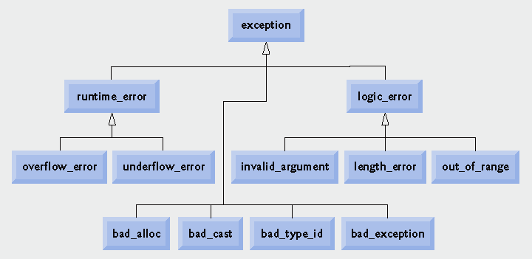
Standard Library Exceptions

Slide 76
Standard Library Exception Hierarchy
Base-class exception
Contains virtual function what for storing error messages
Exception classes derived from exception
bad_alloc – thrown by new
bad_cast – thrown by dynamic_cast
bad_typeid – thrown by typeid
bad_exception – thrown by unexpected
Instead of terminating the program or calling the function specified by set_unexpected Used only if bad_exception is in the function’s throw list

Slide 77
Catching std::exception
#include <iostream>
#include <exception> // for std::exception
#include <string> // for this example
using namespace std;
int main()
{
try
{
// Your code using standard library goes here
// We'll trigger one of these exceptions //intentionally //for the sake of example
string s;
s.resize(-1);
// will trigger a std::bad_alloc
}
// This handler will catch std::exception //and all the derived exceptions too
catch (exception &ex)
{
cout << "Standard exception: " << ex.what() << '\n';
}
return 0;
}
Output:
Standard exception: basic_string::resize

Slide 78
Reference
Books:
Herbert Schildt, ‘C++ The Complete Reference’, Fourth Edition, McGraw Hill Professional, 2011, ISBN-13: 978-0072226805
Robert Lafore, ‘Object-Oriented Programming in C++’, Fourth Edition, Sams Publishing, ISBN: 0672323087, ISBN-13: 978-8131722824
Bjarne Stroustrup, ‘The C++ Programming language’, Third Edition, Pearson Education. ISBN: 9788131705216
K. R. Venugopal, Rajkumar Buyya, T. Ravishankar, ‘Mastering C++’, Tata McGraw-Hill, ISBN 13: 9780074634547
Weblinks:
1. https://nptel.ac.in/courses/106105151/
2. http://nptel.ac.in/syllabus/106106110/
3. http://ocw.mit.edu
MOOCs:
https://onlinecourses.nptel.ac.in/noc18_cs32

Slide 79
Thank You!!

